Slide 1
Unit 203: Electrical installations technology
Fire resistant cables

Slide 2
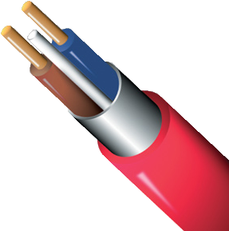
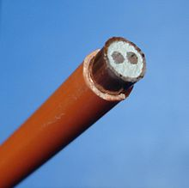
Fire resistant cables
Two types of cable are available for this purpose:
mineral insulated copper clad (MICC)
FP200.

Slide 3
Fire resistant cables
Mineral insulated copper clad (MICC) cable
Advantages:
fireproof
great mechanical strength
waterproof
non-ageing
small overall diameter
high current carrying capacity
earth continuity
high corrosion resistance
high operating temperature.
Disadvantages:
moisture absorption
complicated termination process
cost.

Slide 4
Fire resistant cables
FP200
Conductor
Advantages:
fire resistant
good mechanical strength
waterproof
easy to terminate
relatively cheap compared to MICC.
Disadvantage:
types with silicon insulation require ferrules to be fitted because this insulation is brittle and easily damaged.
Sheath
cpc
Insulation
Screen

Slide 5
Unit 203: Electrical installations technology
The End

